Slide 1

Streaming and Static Recommendation System of Businesses
By,
Mayukha Kalluri
Sri Himaja Bharthepudi

Slide 2
Definition
Recommendation systems are systems that help users discover items they may like.

Slide 3
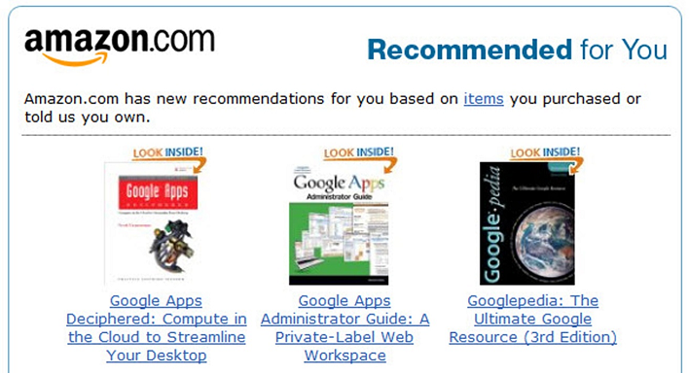

Amazon Recommendations:
Netflix Suggestions:

Slide 4
Some of the messages like
You will also probably like this
Frequently bought together
Products related to this item
Customers who bought this item also bought
Because you have seen X you might also like Y
Recommended for you

Slide 5
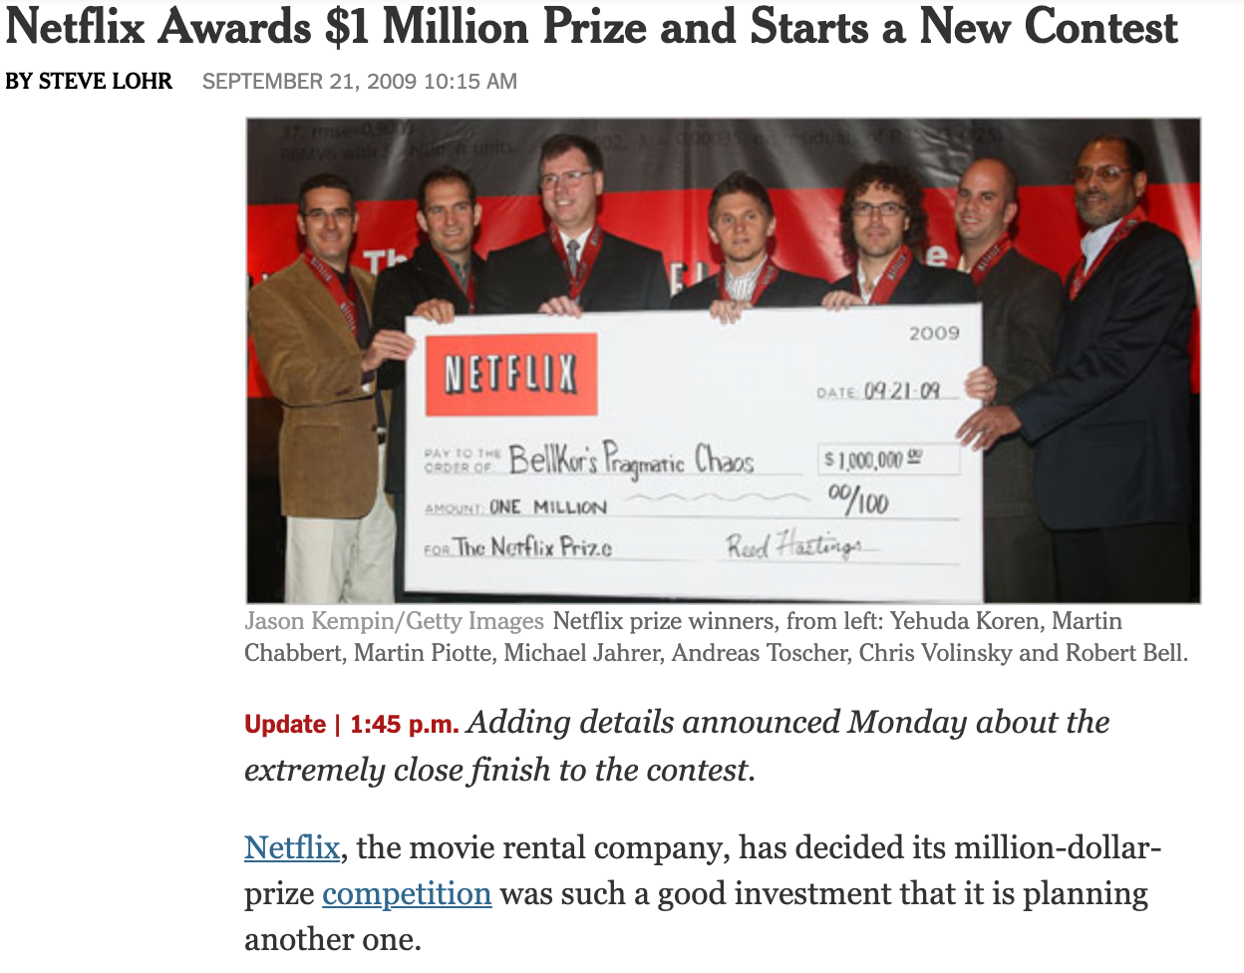
Why do we need a Recommendation System

Slide 6
Some of the Recommendation Systems
Popularity recommenders
Content based recommendation systems
Collaborative filtering

Slide 7
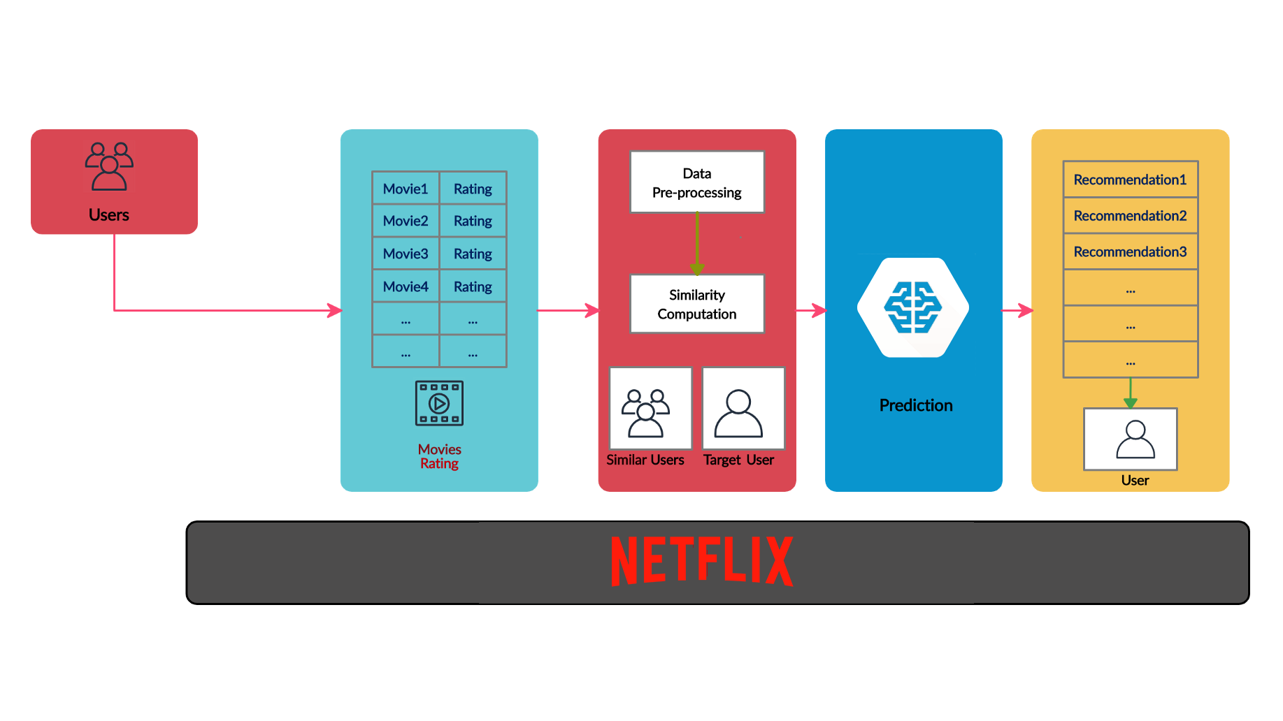

Slide 8
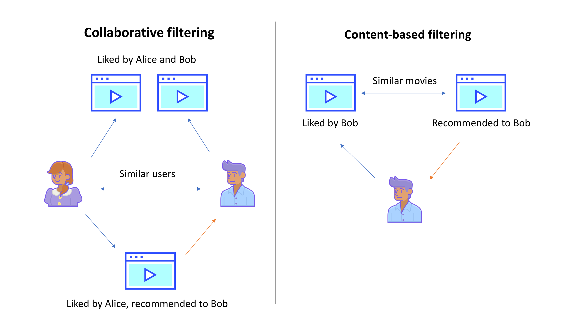

Slide 9
Introduction
We are using the dataset provided by Yelp for this Project
We have developed a Static as well as Streaming recommendation System
Both the parts are User Input Driven and it’s user’s decision to choose a part
Static Recommendation part is Ratings Driven
Streaming Recommendation part is user provided recommendation text Driven

Slide 10
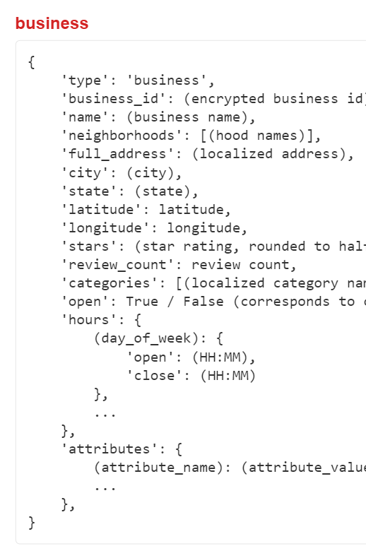
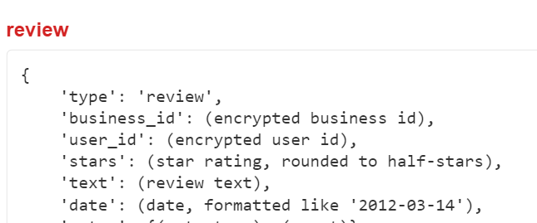
Dataset Description

Slide 11
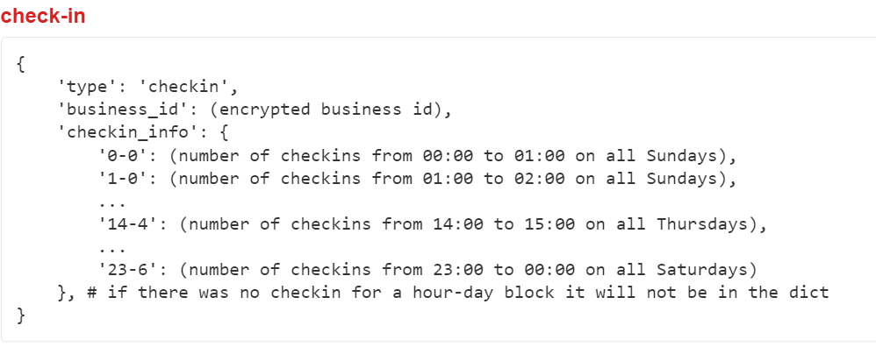
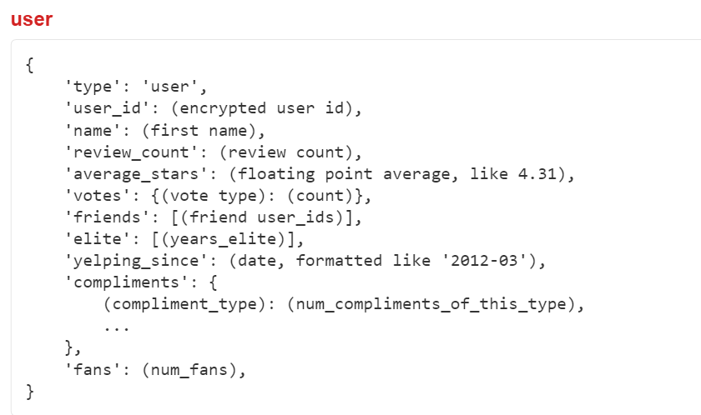
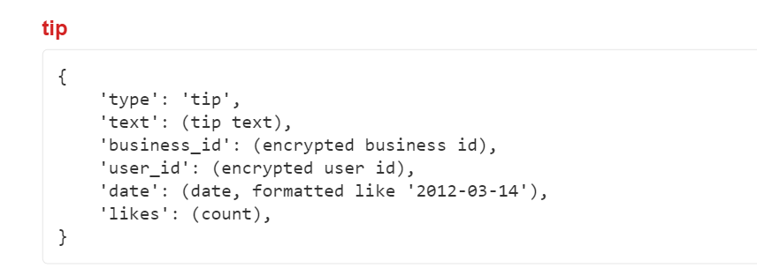

Slide 12
Size Of Data
 | Rows | Size | Description
Businesses | 229,222 | 32MB | Info of businesses
User | 686,557 | 159MB | Users
Reviews | 9,275,055 | 1.8GB | By users
Check-In | 61,050 | 14MB | Timings
Tip | 667,238 | 79MB | Derived from reviews

Slide 13
Pre-Processing
We have the Data in JSON format, we converted it to CSV with the help of Python Pandas
The generated CSV files we further visualized by using R
We couldn’t do this Excel as the data is huge
We removed the unwanted columns using R

Slide 14
Static Recommendation System
Take the input from user and filter the business data file
Input is City, State and the category of Food the user is looking for
Example: City: Atlanta, State: Georgia, Type_Food: Pizza
Target Restaurants -> Finding out the Relevant restaurants based on above input

Slide 15
User Input
Businesses
Filter by
Category of Food,
City and State
Relevant
Businesses
Reviews
Join with
BusinessID
Building an
ALS Matrix
from the Reviews
Filter by
Recent Reviews
Top 5 Rated restaurants

Slide 16
Static Recommendation System
Get the preprocessed Review Data with Ratings, UID, BID and TimeStamp of Review
Join Target Restaurants with Reviews
What if a User Reviews it multiple times ?
Take most recent review of the user
Build an ALS matrix comprising of all the users who have reviewed the target restaurants, use this as Train Data
Test Data will be the (currentUser,ListOfRestaurants)
Filter and Stop the Top 5 Restaurants
What if the user hasn’t reviewed any restaurants in the Category?
We are returning top 5 restaurants based on their average rating

Slide 17
Streaming Recommendation System
Filter the Business Data same as we do for static system
Join the Business Data with Tip Data and write the output to a File (Businesses with Tips)

Slide 18
Business Data
Filter by
City and State
Tip Data
Join with
BusinessID
Apache Kafka
Java
For emulating the Stream
Businesses
with Tips
Streams
Spark Finding Bigrams
Sort and Give the businesses
with Best ratings
User Input
Relevant Businesses

Slide 19
Streaming Recommendation System
Filter the Business Data same as we do for static system
Join the Business Data with Tip Data and write the output to a File
Read this output file with a Java program
This Program acts as a Producer and we are simulating the Streaming Process
The Data is sent to the kafka stream and thereby processed with Spark

Slide 20
Streaming Analysis
Now at the spark side we have rows of (bid::tipdata::rating_of_business)
We are collecting the (bid::tipData) and appending all the tipdata info (reduceByKey) for a bid.

Slide 21
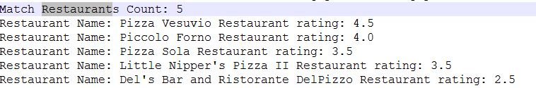
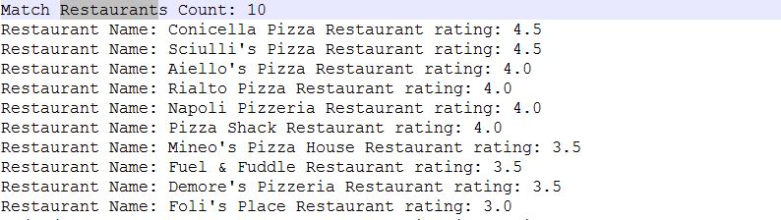
Streaming Output

Slide 22
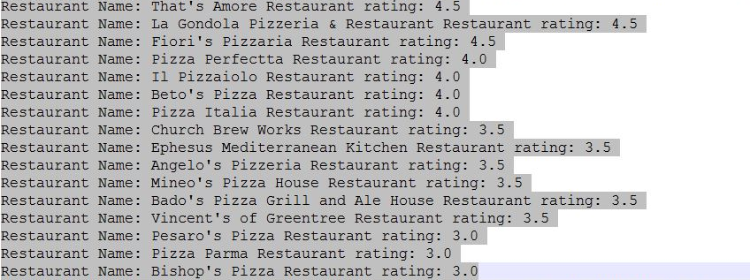
Streaming Output

Slide 23
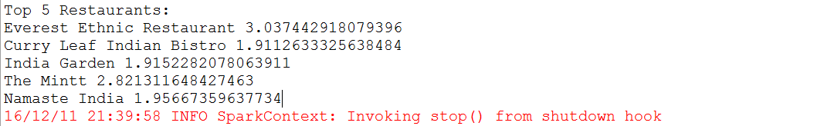
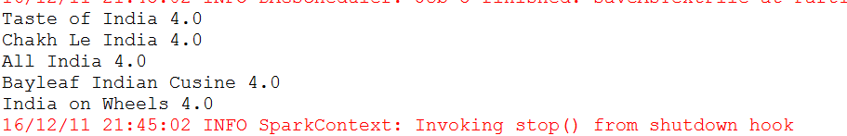
Static Output

Slide 24
Problems Faced
Similar Data Conversion→ excellent => good, amazing => good
Streaming Data from a File (couldn’t do it with command Line)
Less Data for certain use cases

Slide 25
Future Scope
We considered only the positive part of the User Review, can use negative as well to do a sentiment Analysis
Restaurant Specific analysis over the time can be done
Business specific check-in can also be analyzed to give user analysis on busy timings
We considered only bigrams related user input information, we can consider until n grams to get better results

Slide 26
Technologies Used
R (Removing unnecessary attributes)
Python pandas (JSON -> CSV)
Java (as Producer)
Apache Kafka
Scala
Spark with Streaming and MLLib

Slide 27
Thank You

